Slide 1
Unfreeze your gait: tips and tricks for home
Rachel Lehman MSOTR/L, CLT
Tricia creel, Pt, Dpt, nCS
beth Templin, PT, DPT, GCS, COS-C
Notes:
Freezing, strategies for home

Slide 2
Goals of this presentation
Overview of freezing of gait
Education on evidence-based strategies
Strategies to practice at home

Slide 3
What is freezing of gait (fog)?
Brief absence or marked reduction of forward progression of the feet despite the intention to walk.
Three sub-types:
Shuffling with small steps
Trembling in place without forward movement
Total absence of movement
Usually brief
Freezing of Gait Video
(Snijders et al., 2016)
Notes:
Presenter notes: watch video with participants
Snijders, A. H., Takakusaki, K. , Debu, B. , Lozano, A. M., Krishna, V. , Fasano, A. , Aziz, T. Z., Papa, S. M., Factor, S. A. and Hallett, M. (2016), Physiology of freezing of gait. Ann Neurol., 80: 644-659. doi:10.1002/ana.24778

Slide 4
Who Freezes?
Approximately 26% of people with mild PD and 80% of those with severe PD are affected
FOG is more common in later stages of PD
(Peterson et al., 2016)
Notes:
Although it can occur throughout the course of PD, FOG is more common in later stages
Peterson DS, King LA, Cohen RG, Horak FB. Cognitive Contributions to Freezing of Gait in Parkinson Disease: Implications for Physical Rehabilitation. Phys Ther. 2015;96(5):659-70.

Slide 5
Where do they Freeze?
Most commonly experienced at home
63% with turns, 23% initiating walking, 12% narrow spaces, 9% upon reaching destination
(Mancini et al., 2016)
Notes:
Mancini, M., Smulders, K., Cohen, R. G., Horak, F. B., Giladi, N., & Nutt, J. G. (2017). The clinical significance of freezing while turning in Parkinson’s disease. Neuroscience, 343, 222-228. doi:10.1016/j.neuroscience.2016.11.045

Slide 6
when do they freeze?
Decision conflict
Anxiety
Time pressure
Visuospatial conflict
Changing strategy
Shifting focus between tasks
Inhibiting information
Complex task
Go RIGHT!
Go LEFT!
Notes:
Many reasons
Examples- Talking to a friend and walking, being rushed to get into a booth at a restaurant, someone walks out of a door in a hallway as you’re walking by

Slide 7
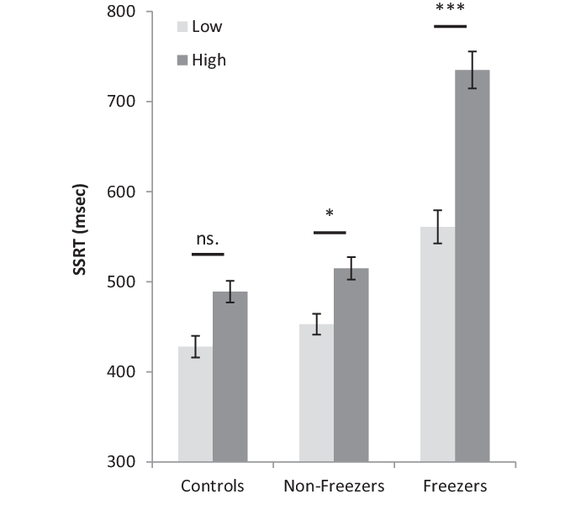
WhEN do people with PD freeze?
(Georgiades et al., 2016)
Notes:
Study looked at the interaction effect of increased cognitive load on stopping performance (how fast can the person stop after receiving a signal). People without PD (control group), people with PD who don’t freeze, people with PD who do freeze, with a high cognitive load in dark grey SSRT was longer. (SSRT = stop signal reaction time)
Georgiades MJ, Gilat M, Ehgoetz Martens KA, Walton CC, Bissett PG, Shine JM, Lewis SJ. Investigating motor initiation and inhibition deficits in patients with Parkinson's disease and freezing of gait using a virtual reality paradigm. Neuroscience. 2016 Nov 19;337:153-162. doi: 10.1016/j.neuroscience.2016.09.019. Epub 2016 Sep 17.PMID: 27651150;
Peterson DS, Pickett KA, Duncan R, Perlmutter J, Earhart GM (2014) Gait-Related Brain Activity in People with Parkinson Disease with Freezing of Gait. PLoS ONE 9(3): e90634. doi:10.1371/journal.pone.0090634
Rubinstein, T. C., Giladi, N., & Hausdorff, J. M. (2002). The power of cueing to circumvent dopamine deficits: A review of physical therapy treatment of gait disturbances in Parkinsons disease. Movement Disorders, 17(6), 1148-1160. doi:10.1002/mds.10259

Slide 8
Why do people with PD freeze?
Cause is poorly understood, multiple areas of the brain involved
Hypotheses:
Difficulty coordinating smooth left/right stepping
Loss of automatic movement
Difficulty maintaining balance and generating steps at the same time
Difficulty processing information about the environment and generating steps at the same time
Impaired eye movements and visual perception of environment
Notes:
People with PD+FoG often exhibit even more pronounced cognitive dysfunction than those who do not experience FoG. In particular, FoG is associated with deficits in attention, especially divided attention
and attentional switching ; executive function, especially shifting and inhibition ; and visuospatial function. (Peterson, et al, 2016)
Freezing of gait: moving forward on a mysterious clinical phenomenon John G Nutt, Bastiaan R Bloem, Nir Giladi, Mark Hallett, Fay B Horak, Alice Nieuwboer Lancet Neurol 2011; 10: 734–44
Peterson, D. S., Plotnik, M., Hausdorff, J. M., & Earhart, G. M. (2012). Evidence for a relationship between bilateral coordination during complex gait tasks and freezing of gait in Parkinsons disease. Parkinsonism & Related Disorders, 18(9), 1022-1026. doi:10.1016/j.parkreldis.2012.05.019
Nemanich ST, Earhart GM (2016) Freezing of gait is associated with increased saccade latency and variability in Parkinson’s disease. Clin Neurophysiol 127:2394–2401. doi: 10.1016/j.clinph.2016.03.017)

Slide 9
Pathophysiology
Notes:
Note: Substantia Nigra produces dopamine but in PD in doesn’t produce dopamine, one of the hall marks of PD and this contributes to freezing. Dot here represents the midbrain, within the midbrain is the substantia nigra. For freezing specifically, the PPN, or pedunculo pontine nucleus is also likely involved in freezing. PPN participates in alertness, movement and muscle tone.
Now we’re going to look at the brain from a different angle. If you take a cross section of the brain at this level and look at the midbrain from the top down this is what you’ll see on MRI
Pedunculopontine nucleus
Functional organization and clinical implications
Eduardo E. Benarroch
Neurology Mar 2013, 80 (12) 1148-1155; DOI: 10.1212/WNL.0b013e3182886a76

Slide 10
Pathophysiology
Notes:
Note: Substantia Nigra becomes atrophied in PD
Source: https://www.researchgate.net/figure/In-this-figure-we-have-displayed-two-images-containing-the-substantia-nigra-in-an-axial_fig6_309440523

Slide 11
Fall risk with freezing
Freezing is unpredictable
can begin and end suddenly
severity of each episode varies
People often try to “fight” through the freezing episode and keep attempting to move forward although their feet are stuck
People who freeze tend to have difficulty recovering and adjusting if they become off balance
Can lead to unsafe strategies for moving, like lunging for a chair instead of turning to sit
(Peterson et al., 2016, Bekkers et al., 2017)
Notes:
Now that we’ve discussed the who/what/when/where and why of FOG, why are we talking about it? Why do we care? Ultimately it’s because FOG increases risk of falls and effects everyday llife…
Peterson, D., & Horak, F. (2016). Effects of freezing of gait on postural motor learning in people with Parkinson’s disease. Neuroscience, 334, 283-289. doi:10.1016/j.neuroscience.2016.08.017
Bekkers, E. M., Dijkstra, B. W., Dockx, K., Heremans, E., Verschueren, S. M., & Nieuwboer, A. (2017). Clinical balance scales indicate worse postural control in people with Parkinson’s disease who exhibit freezing of gait compared to those who do not: A meta-analysis. Gait & Posture, 56, 134-140. doi:10.1016/j.gaitpost.2017.05.009

Slide 12
Medical treatments
FOG usually occurs more often when medication levels are low, when a person is “off”
As the disease progresses, FOG may not respond as well to medication
Subthalamic nucleus deep brain stimulation (DBS)
(Snijders et al., 2016; UpToDate: Medical management of motor fluctuations and dyskinesia in Parkinson disease)
Notes:
So now that we’ve talked about what FOG is and why we care about it, we’re going to talk about what we can do about it. FOG can occur when levodopa levels are low or someone is in an “off” period (also referred to as levodopa-responsive FOG) or at variable frequency and duration when levodopa levels are high and someone is in the "on" state (also referred to as levodopa-related FOG). It is crucial to determine when and how FOG relates to the timing of levodopa doses, as treatment strategies and prognosis vary.
DBS can be an option when FOG occurs in the context of other DBS-responsive motor fluctuations. If you have a tremor that gets better with DBS and you have FOG, it may also get better with DBS.
https://www.uptodate.com/contents/medical-management-of-motor-fluctuations-and-dyskinesia-in-parkinson-disease?search=freezing%20of%20gait&source=search_result&selectedTitle=1~30&usage_type=default&display_rank=1#H869237314
(In case someone asks: Levodopa-responsive FOG occurs during end-of-dose "off" periods and usually responds to shortening levodopa dose intervals or increasing the levodopa dose to avoid "off" episodes. Adding or increasing dopamine agonists is usually not as effective and may even aggravate FOG).
Medication: Carbadopa, levodopa (Sinemet)

Slide 13
VISUAL CUING
The motor program for gait is relatively intact, but people with PD may have difficulty accessing it without sensory input.
Visual cues can provide a “detour” or alternate pathway to help you start walking.
Notes:
Now we’ll discuss non pharmacological treatments and why they’re important.
With freezing, it’s not that you’ve forgotten how to walk, it’s that you have trouble starting to walk
Think of it this way…. There’s a set path in your brain that you use to walk, but with PD you can’t find the beginning of the path to even get started due to a “roadblock”.
Use of visual cues uses a “detour” or alternative pathway to help you.
Visual cuing helps you with your Anticipatory Postural Adjustments, which stabilize your posture to allow you to move the stepping leg off of the ground.
It’s what you do to help get ready to walk that people with PD have the trouble with. And if you can’t get one leg off of the ground, you can’t step forward.
Benefits of visual cuing include:
Increased stride length
Improved initiation of gait
Improved 90/180/360 degree turns
Ginis, P., Nackaerts, E., Nieuwboer, A., & Heremans, E. (2018). Cueing for people with Parkinsons disease with freezing of gait: A narrative review of the state-of-the-art and novel perspectives. Annals of Physical and Rehabilitation Medicine, 61(6), 407-413. doi:10.1016/j.rehab.2017.08.002

Slide 14
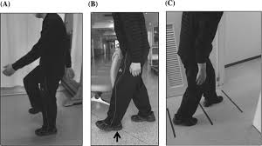
Visual Cuing Techniques
Clock turning
Anticipating number of steps to reach target
Ladder walking, tape lines, colored dots
Assistive devices with visual cues

Slide 15
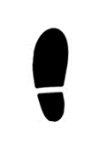
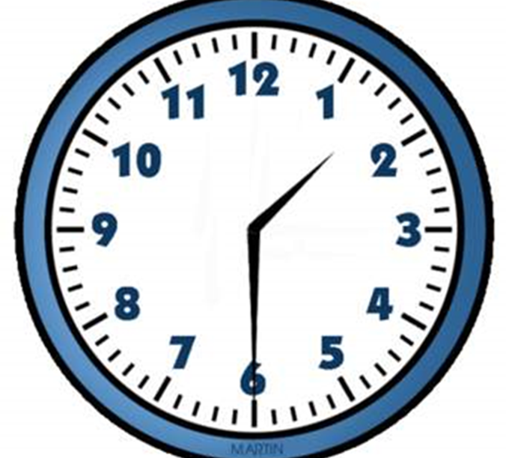
Clock Turn Strategy
(Yang 2016)
Notes:
Imagine a clock on the floor.
Use a step-to pattern to move your feet to point to 3:00, 6:00, 9:00 and then 12:00 to turn in circle.
The clock-turn strategy is an example of a cognitive movement strategy which discourages multi tasking
People who learned this strategy turned faster and with fewer FoG episodes
Yang, W., Hsu, W., Wu, R., & Lin, K. (2016). Immediate Effects of Clock-Turn Strategy on the Pattern and Performance of Narrow Turning in Persons With Parkinson Disease. Journal of Neurologic Physical Therapy, 40(4), 249-256. doi:10.1097/npt.0000000000000148

Slide 16
Anticipating steps to target
Imagine the number of steps you will need to reach a specific target (such as a chair or doorway)
While you walk towards the target, count your steps to see if you can match your goal

Slide 17
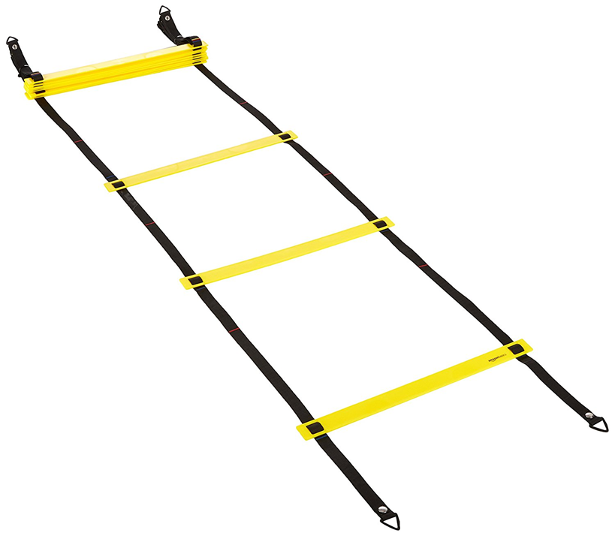
Ladder walking / tape lines
Transverse lines on the floor have been shown to improve gait in people with PD.
Benefits include increased stride length, gait initiation and fewer freezing episodes.
Suteerawattananon et al., 2004; Morris et al., 1996
Notes:
M.E. Morris, R. Iansek, T.A. Matyas and J.J. Summers, Stride length regulation in Parkinson’s disease. Normalization strategies and underlying mechanisms, Brain 119 (1996), 551–568.
M. Suteerawattananon, G.S. Morris, B.R. Etnyre, J. Jankovic and E.J. Protas, Effects of visual and auditory cues on gait in individuals with Parkinson’s disease, Journal of the Neurological Sciences 219 (2004), 63–69.

Slide 18
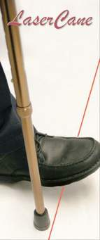
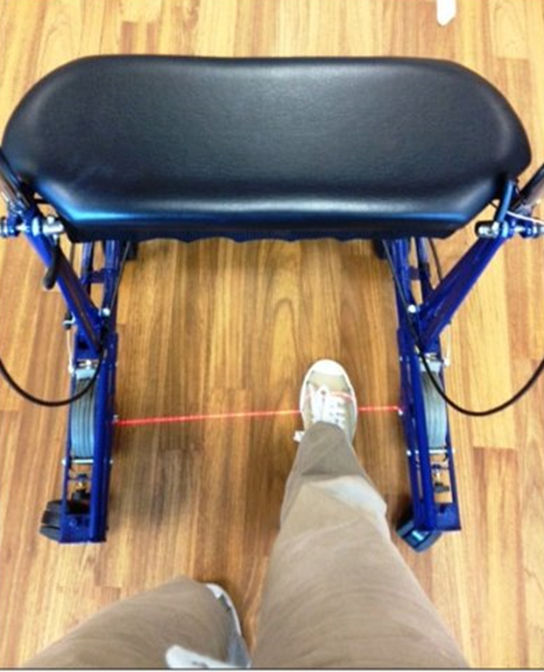
Assistive Devices
Assistive devices such as the Laser Cane and the U-step walker with a laser light can provide a visual cue to provide a target to step on or over to assist with unfreezing.
Notes:
Ustep now makes a LaserCue that be attached to any cane so patients can use the cane of their choice.

Slide 19
Assistive devices
Walking poles have also been found to be beneficial for freezing episodes.
(McCandless, 2016)
Notes:
McCandless et al (2016) Found that laser canes were more effective than walking stick, but both were more effective than the sound metronome.
P.J. McCandless, B.J. Evans, J. Janssen, J. Selfe, A. Churchill, J. Richards. Effect of three cueing devices for people with Parkinson's disease with gait initiation difficulties. Gait Posture, 44 (2016), pp. 7-11

Slide 20
AUDITORY CUING
The motor program for gait is relatively intact, but people with PD may have difficulty accessing it without sensory input.
Auditory cues can provide a “detour” or alternate pathway to help you start walking.
Notes:
Like visual cues, auditory cuing helps you with your Anticipatory Postural Adjustments, which stabilize your posture to allow the stepping leg to get off the ground.
It helps set you up to be a position to take the first step.
This could be a care partner giving you verbal cues, but today we will explore other auditory stimuli that YOU can generate.

Slide 21
AUDITORY Cuing TECHNIQUES
Metronome
Music
Action Sounds (or someone walking with you)
3-2-1 Count Down
Singing to initiate movement
Counting your steps out loud

Slide 22
Metronome
Metronome therapy has been shown to improve walking speed, stride length and reduce episodes of freezing.
(70 beats per minute)
U-Step walkers can come with a built-in metronome
(McCandless, 2016)

Slide 23
Music
Passively listening to music recruits motor areas of the brain even at rest!
People naturally move in synchrony to external cues such as music -> Rhythmic entrainment
(Ashoori et al, 2015)
Notes:
When we hear music, we automatically start to move to the beat. Especially music we like or know well.
Ashoori A, Eagleman DM, Jankovic J. Effects of Auditory Rhythm and Music on Gait Disturbances in Parkinson's Disease. Front Neurol. 2015;6:234. Published 2015 Nov 11. doi:10.3389/fneur.2015.00234

Slide 24
Music
Preferred music tempo is usually 120-130 beats/minute
Women naturally walk at 100-149 strides/minute
Men naturally walk at 103-150 strides/minute
Notes:
People tend to respond better to music than to metronome
People tend to respond better to music with which they are familiar (less cognitive load)
Patients can sustain benefits for prolonged time after exposure

Slide 25
MUSIC
Music Walking Program for Parkinson’s
Notes:
Stop at 1:49

Slide 26
Countdown 3-2-1-go
Significantly improves Anticipatory Postural Adjustments (APAs)
Accomplishes this due to a predictable time between the cue and the needed movement.
Count down “3 – 2 – 1 – Go”
(Lu 2017)
Notes:
Remember those APAs are what you need to get one leg off the floor in order to start walking
The countdown “3-2-1” allows you to prepare before moving on“Go”
Lu, C., Huffmaster, S. L., Tuite, P. J., Vachon, J. M., & Mackinnon, C. D. (2017). Effect of Cue Timing and Modality on Gait Initiation in Parkinson Disease With Freezing of Gait. Archives of Physical Medicine and Rehabilitation, 98(7). doi:10.1016/j.apmr.2017.01.009

Slide 27
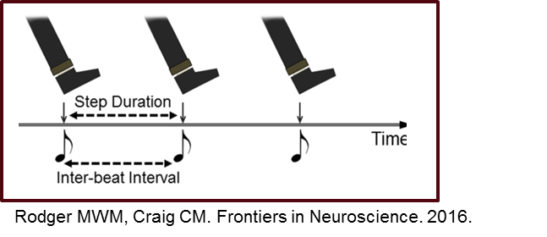
Singing
Singing can be used any time, any place, and doesn’t require anything but your own voice
Any song can work.
Notes:
While listening to music can help restore gait rhythm, internally generated cues (such as singing) may work better
PD can affect the ability to maintain a steady gait rhythm.
Less rhythmic gait is more variable, less stable, singing can help
You can sing out loud, hum to yourself, or sing in your head. Just walk to the beat of the song!
Harrison EC, McNeely ME, Earhart GM. The feasibility of singing to improve gait in Parkinson disease. Gait Posture. 2017;53:224-229. y contribute to falls or freezing of gait.

Slide 28
Walking with a Partner
Study showed that people with FOG responded well to “action sounds” – recorded sounds of footsteps on gravel
One way to replicate this is to walk with a partner, especially if you can hear their footsteps.
Notes:
Young, W. R., Shreve, L., Quinn, E. J., Craig, C., & Bronte-Stewart, H. (2016). Auditory cueing in Parkinsons patients with freezing of gait. What matters most: Action-relevance or cue-continuity? Neuropsychologia, 87, 54-62. doi:10.1016/j.neuropsychologia.2016.04.034

Slide 29
Weight Shifting
Step backward
Side step
Hula hoop hips
Forward kick
Sways
Notes:
The phase between the onset of weight shifting in the initial swing limb, is abnormal in PD patients. Often the duration of the phase is prolonged, and the center of pressure is displaced. The resulting decreased step length during gait initiation may reflect some of these abnormalities in the postural phase. SO – people who freeze may have to CONSIOUSLY initiate weight shifting and it may sometimes need to be in an alternative direction. Also, cue people to pay close attention to the length of the first step after weightshift occurs.
Okada Y, Fukumoto T, Takatori K, Nagino K, Hiraoka K. Abnormalities of the first three steps of gait initiation in patients with Parkinson's disease with freezing of gait. Parkinsons Dis. 2011;2011:202937.

Slide 30
Gait and thinking are connected
Your thinking—specifically, executive function and attention—is critical for mobility
For example, getting up from a chair to answer a phone call while the dog is barking and the phone is in your purse which you stuck under a chair before you went to bed.
You may need to divide attention your attention between two tasks, focus attention on a particular task or inhibit a response if other important information comes in.
Notes:
Even though using external cues can be beneficial, success relies on patients having sufficiently preserved cognitive abilities to consolidate and retrieve these compensatory strategies. Therefore, sometimes people need to rely on their care partner to generate the cues OR they need to make modifications to the activity or the environment to be successful and safe.
Peterson, D. S., King, L. A., Cohen, R. G., & Horak, F. B. (2015). Cognitive Contributions to Freezing of Gait in Parkinson Disease: Implications for Physical Rehabilitation. Physical Therapy, 96(5), 659-670. doi:10.2522/ptj.20140603

Slide 31
attention
One model divides attention into four domains:
Divided
Switching
Sustained
Selective
(McDowd, 2007)
Notes:
McDowd JM. An overview of attention: behavior and brain. J Neurol Phys Ther. 2007;31:98–103.

Slide 32
Divided attention
The ability to do two demanding tasks at the same time
For example, walking and carrying a full glass of water
People with PD often use a “posture-second strategy”
Notes:
If utilized, a posture-second strategy could result in disproportionate posture and gait dysfunction in DT situations. Interestingly, individuals who experience freezing may exhibit even more pronounced “posture-second” prioritization than people with PD−FOG
Bekkers, E. M., Dockx, K., Devan, S., Rossom, S. V., Verschueren, S. M., Bloem, B. R., & Nieuwboer, A. (2018). The Impact of Dual-Tasking on Postural Stability in People With Parkinson’s Disease With and Without Freezing of Gait. Neurorehabilitation and Neural Repair, 32(2), 166-174. doi:10.1177/1545968318761121

Slide 33
switching attention
Switching attention between two tasks
Example, stepping forward and backward
One study found impaired motor switching, but not impaired cognitive switching, in people who freeze
(Smulders et al., 2015)
Notes:
Mobility in complex environments requires constantly switching attention among posture, locomotion, and surrounding sensory input. In people with PD+FoG, the inability to quickly and effectively switch attention during walking, turning, or initiating gait, particularly when completing secondary tasks, such as conversing with a friend, may contribute to freezing episodes and falls.
Smulders, K., Esselink, R. A., Bloem, B. R., & Cools, R. (2015). Freezing of gait in Parkinsons disease is related to impaired motor switching during stepping. Movement Disorders, 30(8), 1090-1097. doi:10.1002/mds.26133 (no studies yet on whether motor switching can be improved by training in PD)

Slide 34
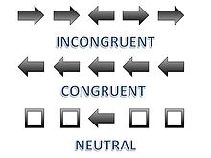
selective attention
Focus on relevant information while tuning out irrelevant info
Additional studies needed to determine if this is more impaired in people who freeze
Flankers Task
Notes:
Selective attention is similar to the inhibition domain of executive function. These domains are commonly assessed with the flanker task, in which an individual must discern the direction an arrow is pointing while ignoring the directions of the flanking arrows.

Slide 35
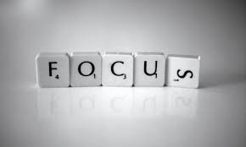
Sustained attention
Ability to focus on a task for a prolonged period
Not well studied, but indications are that there is no difference between people who freeze and those who don’t in this domain
Cohen et al., 2014
Notes:
This domain of attention has not been thoroughly investigated with respect to FoG. However, one recent study showed that performance on Mackworth's sustained attention task was similar between people with PD+FoG and those with PD−FoG.
Cohen RG, Klein KA, Nomura M, et al. Inhibition, executive function, and freezing of gait. J Parkinsons Dis. 2014;4:111–122.

Slide 36
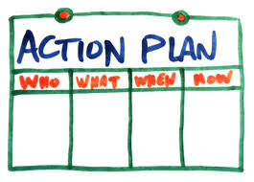
How do people learn?
Plan of Action
Identify areas of concern
Set goals
Write down specific action plan
Practice, Practice, Practice!!
Acquisition of new skill takes many repetitions
Shift to automatization takes even more repetitions
Self-generated information is the best
(Barrett et al., 2000; Goverover et al., 2011; Schefft et al., 2008)
Notes:
To really learn these skills we discussed today and find strategies that work for you…
Give example with freezing

Slide 37
Goal -> plan -> do -> check
GOAL
From Cognitive Orientation to Daily Occupational Performance (CO-OP) (Polatajko et al.)
Slide compliments of Erin R. Foster, OTD, MSCI, OTR/L
What do I want to do?
CHECK
Did I do my plan?
Did my plan work?
PLAN
How
(self talk, body position, modify task, feel movement, verbal reminder)
When
(how long, how often)
Where
No
Yes
Goal is achieved
DO
The plan

Slide 38
Thank you
Everyone at the APDA
All of you for attending and being willing and motivated to learn
Notes:
Take time to address audience

