Slide 1
Poopin’ N Peein’ in PD: Can’t Go At All, Gotta Go Right NOW!
Johanna Hartlein, APRN
Washington University School of Medicine
Department of Neurology, Movement Disorders Section

Slide 2
Non-motor Symptoms of PD
Depression, Irritability, Anxiety, Apathy
Confusion, Loss of Concentration, Trouble with attention
Hallucinations
Trouble swallowing, Soft voice (mixed motor and nonmotor)
Constipation, Feeling full sooner, Decreased appetite, Weight loss
Urinary issues
Blood pressure fluctuations
Insomnia or Excessive Daytime Sleepiness/Fatigue
REM sleep behavior disorder
Loss of sense of smell
Seborrhea
Drooling, Runny nose, Dry or Watery Eyes (mixed motor and nonmotor)
Vision problems
Impulse control problems

Slide 3
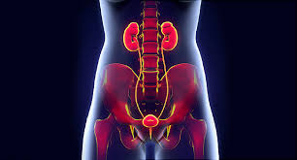
Urinary Problems in PD
Urgency
Frequency
Nocturia
Incontinence, Dribbling
Weak flow
Trouble starting flow
Trouble emptying bladder fully
UTI

Slide 4
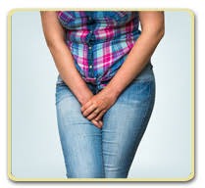
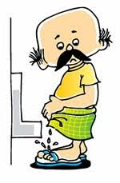
What is the difference in all of these urinary issues?
Overactive Bladder vs Overflow Bladder
Urinary urgency, frequency, nocturia, incontinence = Storage symptoms
Urinary hesitancy, interrupted or poor stream, double voiding, urinary retention = Voiding symptoms
Dribbling before reaching potty is likely a storage symptom
Dribbling after finishing urinating is likely a voiding symptom

Slide 5
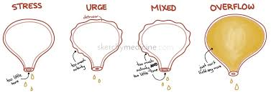
Types of urinary incontinence
Stress incontinence – leakage caused by activity, sneezing or coughing.
Urge incontinence – leakage following sudden urge to urinate without being able to control that urge.
Overflow incontinence – leakage caused by ‘overflow’ of urine from an overly full bladder because of not completely emptying the bladder.
Mixed incontinence – typically a combination of both urge and stress incontinence. Most common type in women.
Sometimes people have mixed incomplete emptying and urge incontinence

Slide 6
How common are these problems?
Urinary issues can cause UTI, social isolation, embarrassment, decreased quality of life
Some type of urinary problem: 57.3%
Significantly more common & sooner in MSA: 60-100%
This is much more common than in the general population
Usual onset in PD: ~6 years after motor symptoms
More likely as you age and as PD progresses
Storage symptoms: 57-83% of PD patients
Nocturia (having to pee at night): >60% of PD patient
Urinary frequency: 16-36% of PD patients
Urinary urgency: 33-54% of PD patients
Voiding symptoms: 17-27% of PD patients (much more common in MSA)
PD women tend to have lower residual volumes (after voiding) and decreased bladder capacity

Slide 7
What causes urinary problems in PD?
Its ultimately coming from your brain—”Neurogenic Bladder Control”
Somatic and autonomic nervous system allow safe storage and appropriate, efficient voiding
Areas of Nervous System involved: Pons, sacral spinal cord, peripheral nerves, sympathetic and parasympathetic nervous system, midbrain (dopaminergic neurons in substantia nigra, basal ganglia, thalamus, striatum), cerebral cortex, cerebellum
Dopamine loss results in partial or total disconnection of the micturition reflex from the voluntary control centers, resulting in frequent detrusor contractions at low bladder volumes. This means: You can’t hold as much
Detrusor overactivity seen in 45-93% of PD patients (urge incontinence, frequency, nocturia)
Urethral sphincter bradykinesia: 11%, incomplete relaxation of pelvic floor: 37% (hesitancy, weak stream, incomplete emptying)
Small bladder capacity seen in 46% of PD patients

Slide 8
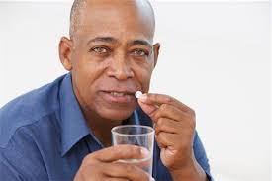
Could PD medicine affect the bladder problems?
Unclear
A few studies showed improvement in bladder capacity while one showed it worsened bladder capacity
One study showed levodopa worsened detrusor overactivity in some people and improved it in others
One study showed levodopa worsened detrusor overactivity during storage and improved bladder empting

Slide 9
Other considerations because its not always “Just PD”
Benign Prostatic Hypertrophy in men
Stress incontinence, especially in women
Rule out UTI as a cause(sometimes these happen as a result of bladder problems though)
Outlet obstruction problems (usually in men)
Peripheral nerve diseases
Diabetes
Spinal stenosis
Tumors, fibroids, vaginal prolapse (women)
Overactive bladder is most common in men and in PD (which is 2:1 male/female), also OAB is most common urinary issue with aging
This can make things tricky in determining cause

Slide 10
Meds for overactive bladder (urgency, frequency, incontinence, nocturia)
Anticholinergic medicines
Tolterodine (Detrol), Trospium, Oxybutynin (Ditropan, Oxytrol), Fesoterodine (Toviaz), Darifenacin (Enablex), Solifenacin (Vesicare)
UH OH!!!! THESE CAN ALL CAUSE OR WORSEN CONFUSION AND/OR HALLUCINATIONS, WORSEN CONSTIPATION, WORSEN DRY MOUTH AND CAN CAUSE SLEEPINESS
We generally use Trospium as the safest of these drugs as it has minimal Blood-Brain barrier penetration
Myrbetriq
Different kind of drug, we don’t think it worsens confusion, hallucinations, sleepiness
Expensive
Can raise blood pressure (a good thing in some of our patients)

Slide 11
Other meds for OAB
Imipramine
Can also help depression
May help with both urge and stress incontinence
Can cause drowsiness, worsen constipation
Duloxetine
Can also help with depression, neuropathic pain
I haven’t seen this work frequently in PD for OAB
Botox
Sometimes effective, may increase UTI risk as it weakens bladder muscle and can cause urinary retention
Estrogen in women
I have seldom seen this work
May not be safe with history of “female parts” cancers

Slide 12
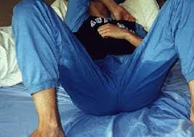
Med for Nocturia
Desmopressin
Used for bedwetting in kids
Could cause confusion
Could cause low sodium and that can be dangerous
Otherwise, the med used depends on which kind of bladder issue you have (storage problem or voiding problem)

Slide 13
Medicine for urinary retention, weak stream, trouble starting flow (overflow incontinence)
Really should see a urologist first to rule out significant bladder outflow obstruction and to have a post void residual
Alpha blockers/5-alpha reductase inhibitors
Alfuzosin (Uroxetral), Prazosin (Minipress), Doxazosin (Cardura),Tamsulosin (Flomax), Silodosin (Rapaflo)
UH OH, THESE CAN DROP BLOOD PRESSURES IN PEOPLE WHO ALREADY HAVE ORTHOSTATIC HYPOTENSION IN PD AND MUST BE USED CAUTIOUSLY, ESPECIALLY IN PEOPLE WITH MSA, WHO ARE PRONE TO DROPS IN BP
But they don’t cause confusion
They can worsen urgency
Surgery for relief of obstruction and to avoid self cath

Slide 14
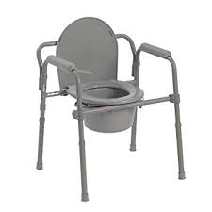
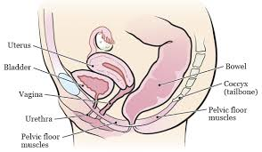
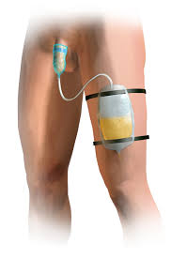
Non-medicine treatment for urinary problems
Bladder retraining (50% reduction of symptoms in one study)
Scheduling bathroom breaks versus waiting to feel the urge, bladder diaries lead the way
Being sure you are not constipated
Limiting fluids near bedtime (3 hrs before bed, NOT all day long)
Clear path to bathroom at night & use nightlights
Pads, Adult Underwear
Bedside commode
Stop diuretic meds if possible (not always possible for heart failure patients)
Lose weight if heavy
Condom catheters at night for men
Likely increase the risk of UTI so some urologists refuse these
Give up coffee and soda and tea (the caffeine plus the acidity)
But we use this to treat daytime sleepiness all of the time
Stop smoking, stop drinking alcohol (go to Church for fun)
Pelvic floor exercises and biofeedback sometimes helpful (Kegels included), especially in women
Having to self catheterize to empty is rare in PD
Neuromodulation has not been studied well in PD or other causes of neurogenic bladder
One small study for sacral nerve modulation showed some sort term improvement
One medium study for posterior tibial nerve stimulation showed significant short term improvement

Slide 15
How do I know if I have overactive bladder, urinary retention (overflow) or both?
People can have either problem or a mix of BOTH problems
You need to see a urologist for at least post-void residual and possibly urodynamic testing to figure this out
I do not know of any urologists who specialized in PD in STL

Slide 16
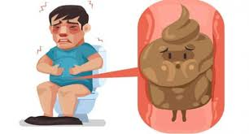
Constipation in PD
Occurs in up to 2/3 of patients with PD (66-80%)
Causes psychological and social distress
Decreases quality of life of PD patient and carepartner
May occur 20+ years before motor symptoms
Definition (2 or more of the following that started at least 6 months ago and persisted in at least ¼ of BMs for at least 3 months)
Straining during at least ¼ of BMs
Sensation of incomplete evacuation at least ¼ of BMs
Lumpy or hard stools at least ¼ of BMs
Manual maneuvers required in ¼ of BMs
Loose stools rarely present
No Irritable Bowel Disease or other structural abnormalities
NOT EVERYONE GOES EVERY DAY, THAT’S OKAY!

Slide 17
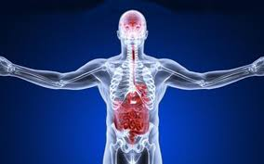
What causes constipation in PD
Again, it stems from your brain sending the wrong impulses
Autonomic nervous system dysfunction
Colonic Symptoms (storage)—slow intestinal transit
Decreased frequency of stools, hard stools
Transit time is nearly doubled in PD patients
Anorectal symptoms (voiding)—outlet obstruction (sphincter contracts versus relaxes when its time to go)
Straining to go, incomplete passage of stool
Physical weakness
Lack of exercise
Antacids with calcium (Caltrate, Tums, Rolaids, Alka-Seltzer) or aluminum (Gaviscon, Mylanta)
Lack of fiber
Reduced fluid intake
Side effect of almost every medicine on the market (Artane, Cogentin, all opioid “pain pills”, iron pills, tricyclic antidepressants such as amitriptyline)

Slide 18
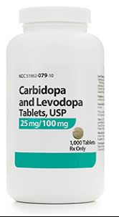
Do my PD meds make me constipated or help me to go?
Not at all clear
Constipation & diarrhea listed as side effects
One study of 18 never treated PD patients showed no change in bowel frequency or defecation difficulty after 3 months on levodopa.
A few studies suggest PD meds contribute to worsened constipation
One study showed levodopa may help outlet obstruction

Slide 19
Results of constipation
Going 3 days or more with no BM causes stools to become hard and difficult to pass
Straining can cause painful hemorrhoids
Sometimes constipation produces watery stools (because there is a boulder in your gut)
Constipation can cause diverticulosis (weakening of colon wall with risk of infection and bleeding)
Constipation can lead to bowel blockages with hospitalizations and/or surgery
Severe constipation can cause the gut to have “a stroke” because blood supply can be blocked when bowels are too full
This can result in surgery and possibly an ostomy bag
If you are “full of it”, you cannot absorb your PD medicines as well
Constipation means your stomach can’t empty because your intestines are full, this will worsen appetite and can lead to weight loss
Constipation can worsen bladder symptoms (and vice versa)
Constipation may increase your risk for colon cancer

Slide 20
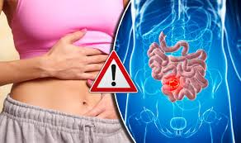
Other causes of constipation
Hypothyroidism
Colon/anal stricture
Cancer
Enlarged prostate
Hypercalcemia
Diabetes
Irritable Bowel Syndrome
Spinal cord lesions

Slide 21
Treatment “supplements”
Prune juice, applesauce, bran
Avoid mineral oil, castor oil (risk of aspiration, nutritional deficiencies)
Caffeine
Dai-Kenchu-To: (ginger, ginseng, zanthoxylum) did not stand up to placebo
Soluble fiber supplements (pectin may be better than psyllium)
Examples: Metamucil, Fibercon, Citrucel, Benefiber
Severity of constipation improved significantly with at least 4 BMs/week that were looser with pectin/wheat/demetylpolyoxhexane
Unless taken with adequate fluids, adding fiber can worsen constipation
These can slow gastric emptying time, making you feel full for longer
Probiotics (Lactobacillus casei shirota) plus fiber
Seemed to help more with bloating, hard stools, and being able to completely empty than with BM frequency

Slide 22
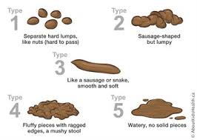
Stool Softeners
These are good for hard stools if that is the main reason you have trouble with BMs
They may not increase the number of BMs/week though
Sometimes people with PD need double or triple the recommended dose
Sometimes that still doesn’t do the trick and you must add a laxative
Sometimes too much causes diarrhea
Sometimes the “too much” dose changes
Some common types
Docusate (Colace)

Slide 23
Laxatives
Lets face it—most people with PD need laxatives regularly so stop worrying so much about dependence and worry more about pooping
All can cause diarrhea or cramping
Don’t wait to be constipated to take these. Take them to keep regular.
Polyethylene Glycol (Miralax) & Milk of Magnesia
By far what we use the most
Gentle laxative, increases fluid in the colon
Some need it 2-3x/day, others daily, others a few times/week, others only as needed
Improved stool frequency, consistency, and straining in 2 small studies (Macrogel)
Stimulant laxatives (Dulcolax/Bisacodyl) or Senna/Senokot)
Promote muscle contraction in the gut; may cause more cramping and dependence
Cisapride (banned), Tegaserod/Zelnorm (recently reapproved), Mosapride
All are serotonin agents
Tegaserod and Cisapride banned in some places for risk of fatal cardiac arrhythmias
Relamorelin (ghrelin agonist)
sub-Q produced too high stool frequency
Not approved in USA (studies ongoing for diabetic gastroparesis)

Slide 24
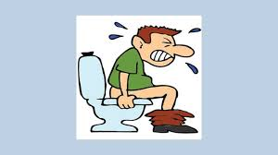
Prescription meds for constipation (IBS drugs)
Amitiza (lubiprostone)
softens stools, increases gut motility
Significant improvement in 5/27 subjects, some improvement in most subjects
Expensive
Watch for diarrhea, cramping, nausea
Linzess (linaclotide) or Trulance (plecanatide)
Neither have been formally studies in PD
Improve slow transit constipation
Expensive
Watch for diarrhea, headache, abdominal pain, fatigue
We usually start with Linzess (less cramping?)

Slide 25
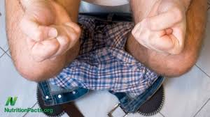
Nonabsorbable sugars
None have been studied in PD
Work by increasing water in stool
Generally work at a much slower rate as Miralax or not at all
Examples include lactulose or sorbitol
Primary side effect is bloating

Slide 26
Enemas, Suppositories and Botox, Oh My!
Glycerine suppositories are a good option
Osmotic and stimulant properties
Some people like Dulcolax suppositories but they can be habit forming
“Fleets” Enemas are okay but when possible, we prefer to avoid them because of risk of dependence and well, because it is putting something up your butt
Can also cause bloating and cramping
Botox to the puborectal muscle may help those with outlet obstruction (straining, incomplete emptying of the bowel) in PD but these studies were fairly small and botox is shots

Slide 27
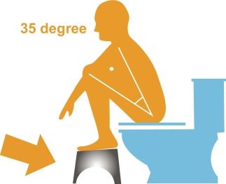
Using a small step stool to raise feet during BMs for proper positioning

Slide 28
Other nonmedicinal options
Abdominal massage did not seem to help in one small PD study
One study showed mild improvement with functional magnetic stimulation of the thoracic and lumbrosacral nerves in PD patients treated already with laxatives and enemas
Increase fiber in the diet (fruits with edible seeds, veggies, legumes, whole grain bread/cereal)
DBS may improve constipation—but we would never do DBS FOR constipation
Increase fluid intake (1.5 to 2 quarts daily not counting milk products or caffeine products) Hahahahahahahaha—never going to happen
Exercise
Move bowels as soon as you feel the urge
Please talk to your doctor and don’t be embarrASSed
After all, he/she poops too

